Slide 1

DIGITAL LOGIC DESIGN (111776)
Dr. Owais Hussain

Slide 2

Agenda
Multiplexers
2-1 MUX
4-1 MUX
8-1 MUX
N-1 MUX
Constructing N-1 MUX using Multiple MUXs
MUX as Universal gate
Demultiplexers
Difference b/w MUX & DEMUX

Slide 3
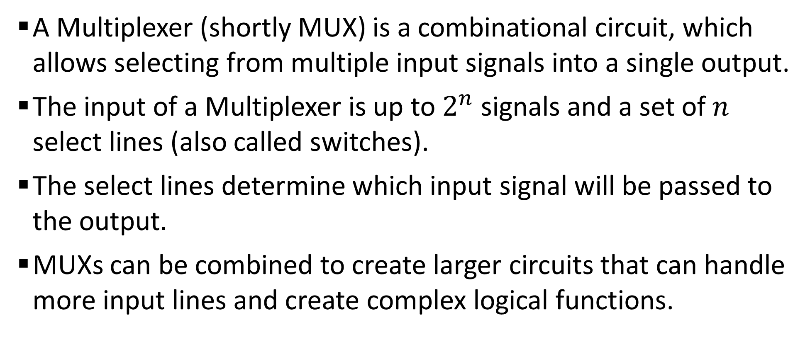
Sample 2
Multiplexers
A Multiplexer (shortly MUX) is a combinational circuit, which allows selecting from multiple input signals into a single output.
The input of a Multiplexer is up to $2^{n}$ signals and a set of $n$ select lines (also called switches).
The select lines determine which input signal will be passed to the output$.$
MUXs can be combined to create larger circuits that can handle more input lines and create complex logical functions.

Slide 4
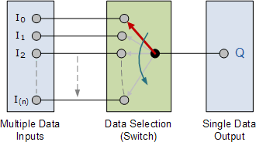
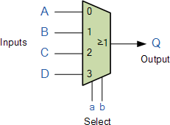
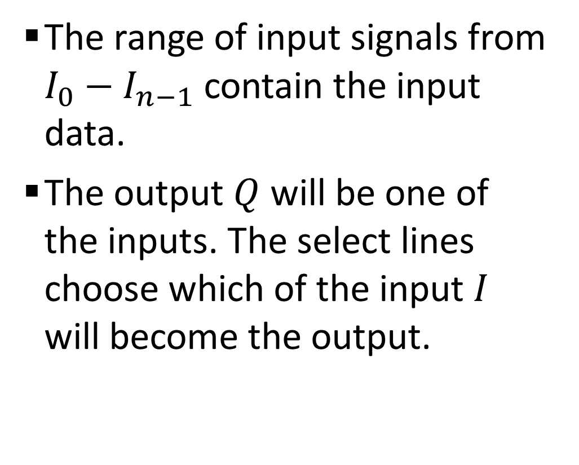
Sample 2
Multiplexers
The range of input signals from $I_{0}−I_{n−1}$ contain the input data.
The output $Q$ will be one of the inputs. The select lines choose which of the input $I$ will become the output.

Slide 5
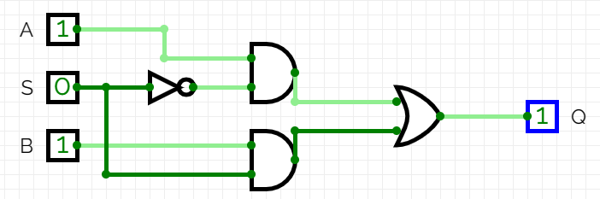
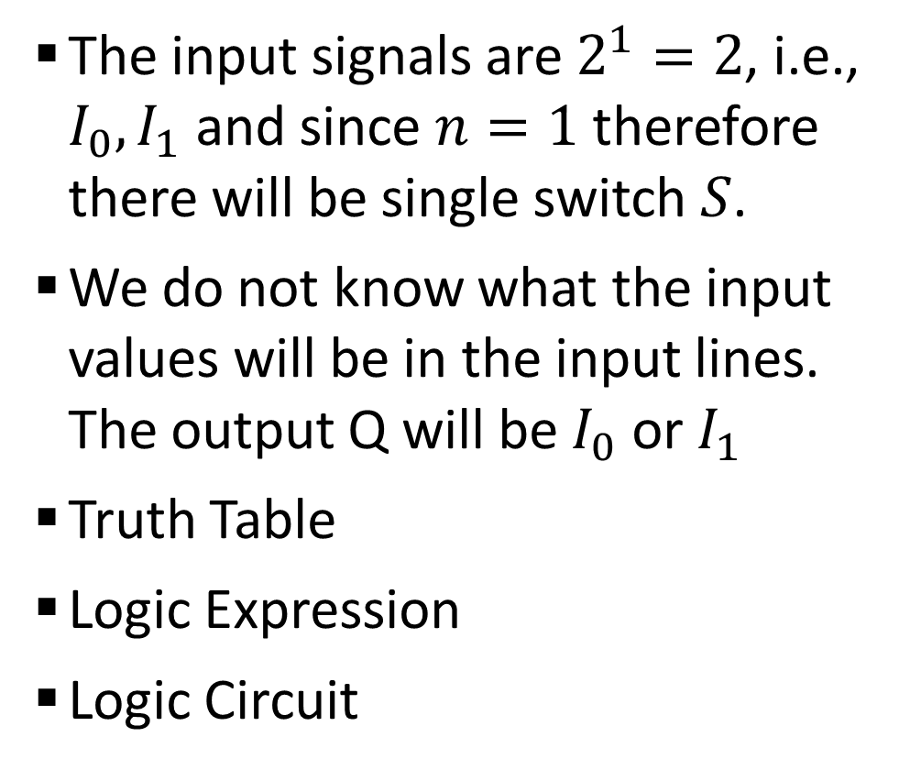

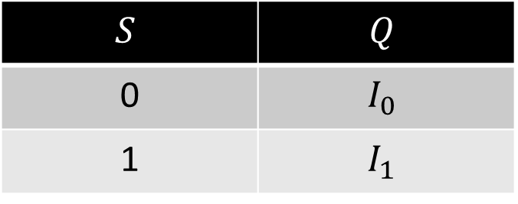
Sample 2
2-1 MUX
The input signals are $2^{1}=2$, i.e., $I_{0},I_{1}$ and since $n=1$ therefore there will be single switch $S$.
We do not know what the input values will be in the input lines. The output Q will be $I_{0}$ or $I_{1}$
Truth Table
Logic Expression
Logic Circuit
$$S$$ | $$Q$$
0 | $$I_{0}$$
1 | $$I_{1}$$
$$Q=I_{0}\overline{S}+I_{1}S$$

Slide 6
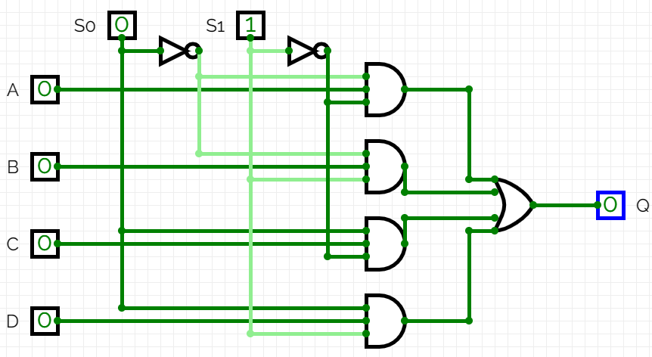
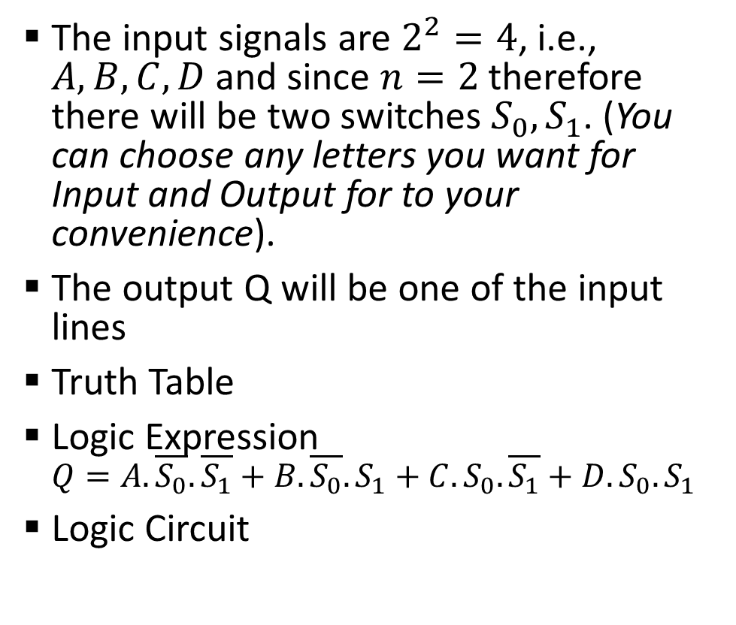
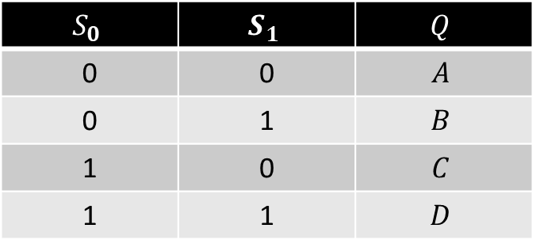
Sample 2
4-1 MUX
The input signals are $2^{2}=4$, i.e., $A,B,C,D$ and since $n=2$ therefore there will be two switches $S_{0},S_{1}$. (You can choose any letters you want for Input and Output for to your convenience).
The output Q will be one of the input lines
Truth Table
Logic Expression $Q=A.\overline{S_{0}}.\overline{S_{1}}+B.\overline{S_{0}}.S_{1}+C.S_{0}.\overline{S_{1}}+D.S_{0}.S_{1}$
Logic Circuit
$$S_{0}$$ | $$S_{1}$$ | $$Q$$
0 | 0 | $$A$$
0 | 1 | $$B$$
1 | 0 | $$C$$
1 | 1 | $$D$$

Slide 7
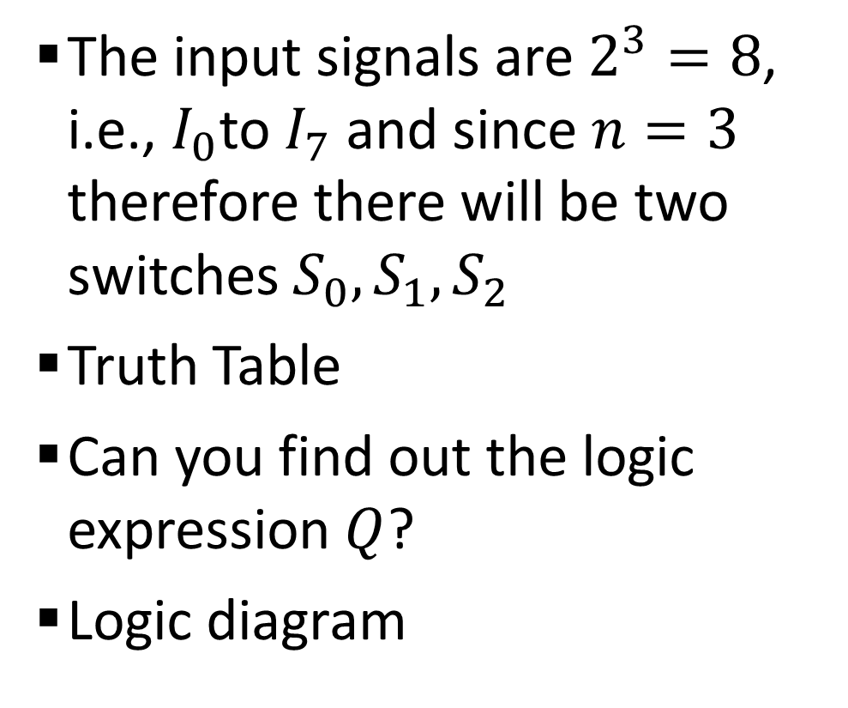
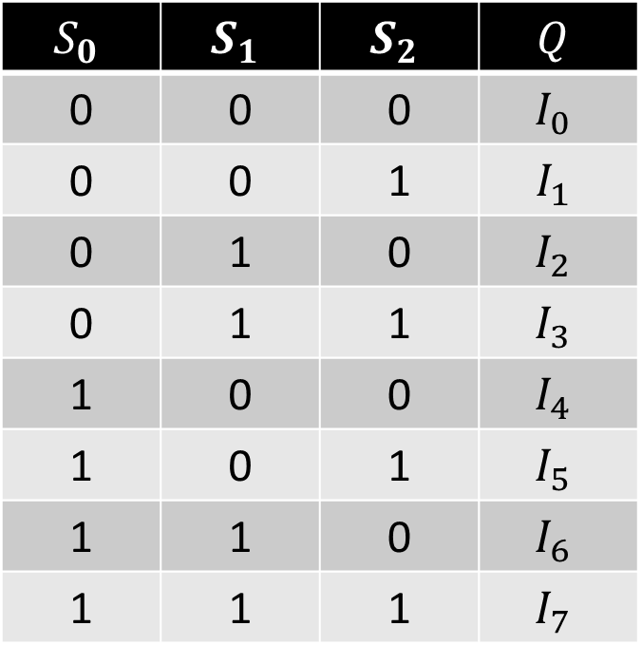
Sample 2
8-1 MUX
The input signals are $2^{3}=8$, i.e., $I_{0}$to $I_{7}$ and since $n=3$ therefore there will be two switches $S_{0},S_{1},S_{2}$
Truth Table
Can you find out the logic expression $Q$?
Logic diagram
$$S_{0}$$ | $$S_{1}$$ | $$S_{2}$$ | $$Q$$
0 | 0 | 0 | $$I_{0}$$
0 | 0 | 1 | $$I_{1}$$
0 | 1 | 0 | $$I_{2}$$
0 | 1 | 1 | $$I_{3}$$
1 | 0 | 0 | $$I_{4}$$
1 | 0 | 1 | $$I_{5}$$
1 | 1 | 0 | $$I_{6}$$
1 | 1 | 1 | $$I_{7}$$

Slide 8
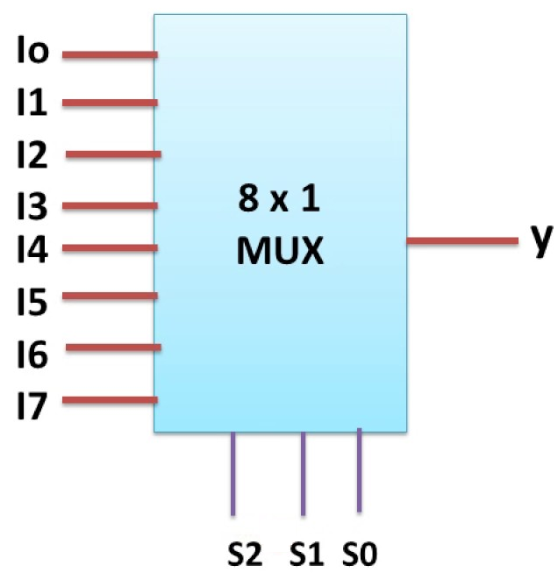
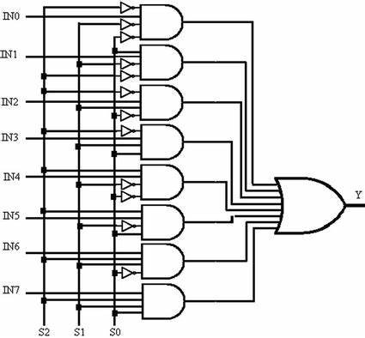
Sample 2
8-1 MUX

Slide 9
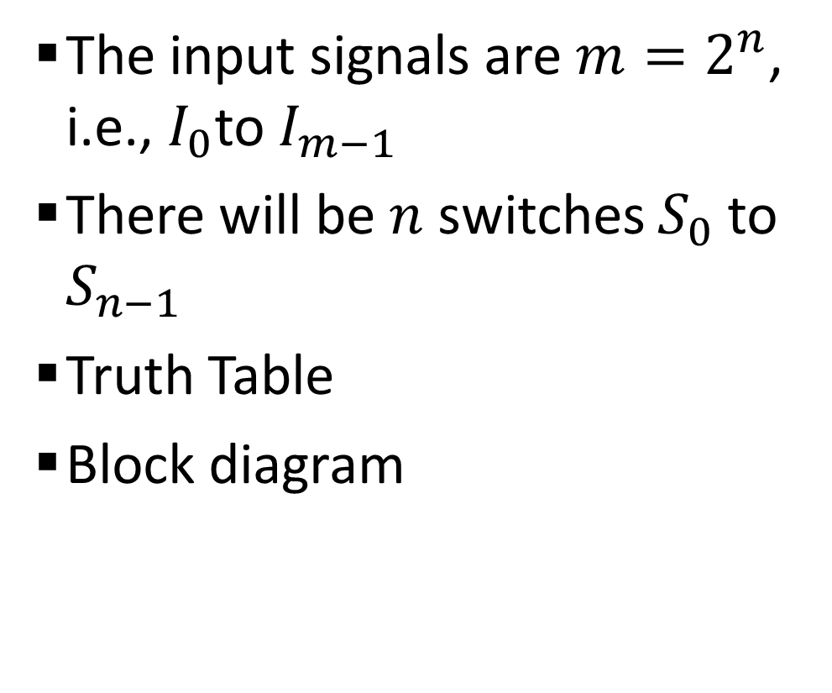
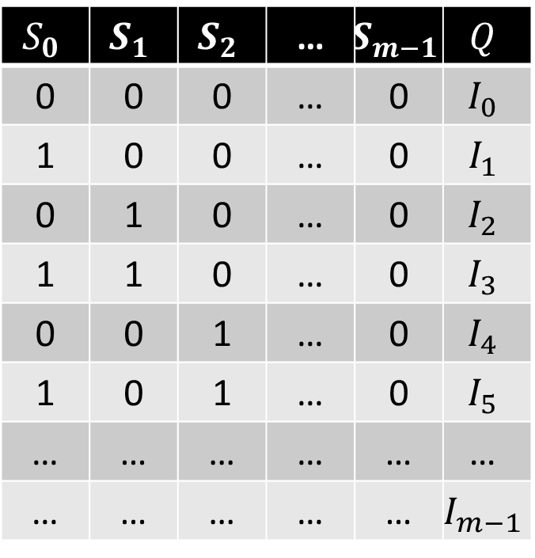
Sample 2
N-1 MUX
The input signals are $m=2^{n}$, i.e., $I_{0}$to $I_{m−1}$
There will be $n$ switches $S_{0}$ to $S_{n−1}$
Truth Table
Block diagram
$$S_{0}$$ | $$S_{1}$$ | $$S_{2}$$ | … | $$S_{m−1}$$ | $$Q$$
0 | 0 | 0 | … | 0 | $$I_{0}$$
1 | 0 | 0 | … | 0 | $$I_{1}$$
0 | 1 | 0 | … | 0 | $$I_{2}$$
1 | 1 | 0 | … | 0 | $$I_{3}$$
0 | 0 | 1 | … | 0 | $$I_{4}$$
1 | 0 | 1 | … | 0 | $$I_{5}$$
… | … | … | … | … | $$\text{…}$$
… | … | … | … | … | $$I_{m−1}$$

Slide 10
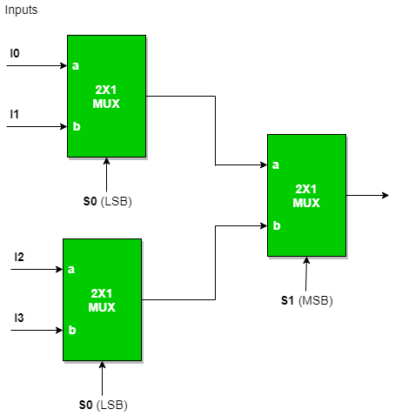
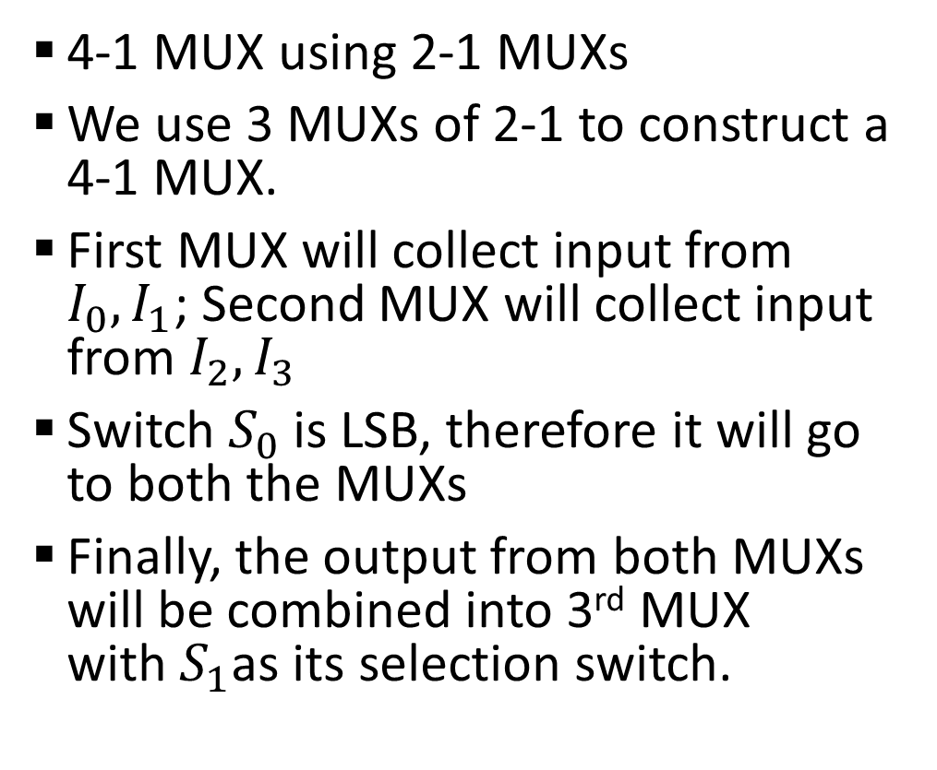
Sample 2
Constructing N-1 MUX using Multiple MUXs
4-1 MUX using 2-1 MUXs
We use 3 MUXs of 2-1 to construct a 4-1 MUX.
First MUX will collect input from $I_{0},I_{1}$; Second MUX will collect input from $I_{2},I_{3}$
Switch $S_{0}$ is LSB, therefore it will go to both the MUXs
Finally, the output from both MUXs will be combined into 3rd MUX with$S_{1}$as its selection switch.
Notes:
Exercise: Suppose the input $I$ is the Binary for for number 9. Simulate the circuit using $S_{0}=1;S_{1}=1$

Slide 11
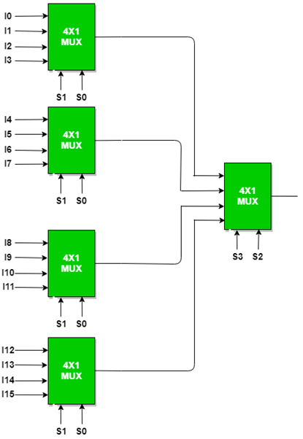
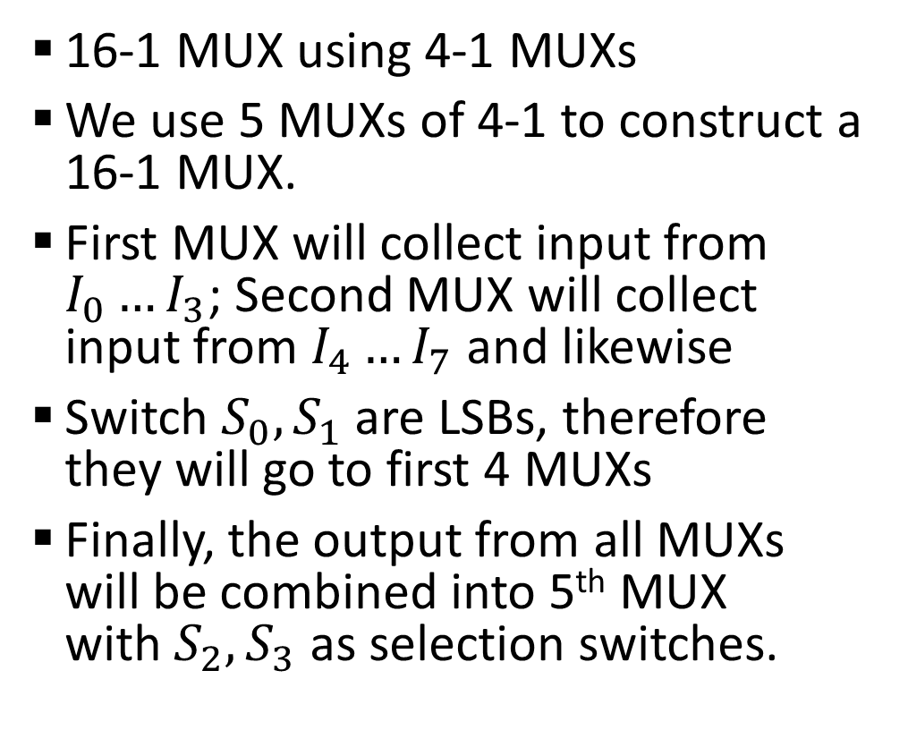
Sample 2
Constructing N-1 MUX using Multiple MUXs
16-1 MUX using 4-1 MUXs
We use 5 MUXs of 4-1 to construct a 16-1 MUX.
First MUX will collect input from $I_{0}…I_{3}$; Second MUX will collect input from $I_{4}…I_{7}$and likewise
Switch $S_{0},S_{1}$ are LSBs, therefore they will go to first 4 MUXs
Finally, the output from all MUXs will be combined into 5th MUX with$S_{2},S_{3}$ as selection switches.
Notes:
Exercise: Suppose the input $I$ is the Binary for for number 9. Simulate the circuit using $S_{0}=1;S_{1}=1$

Slide 12
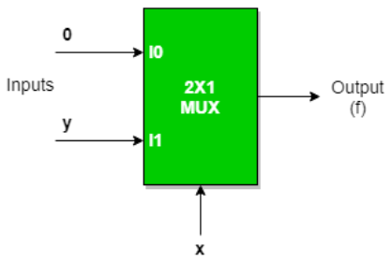
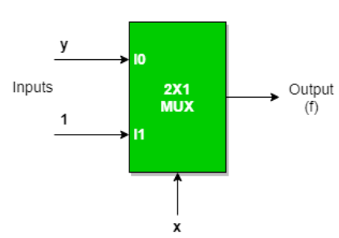
Sample 2
MUX as Universal Gate
AND gate
OR gate
Can you make NOT gate?
Notes:
Yes, NOT gate can easily be made. If we supply $x$ as input to switch; $I_{0}=1$ and $I_{1}=0$ then $y$ will be $x′$.

Slide 13
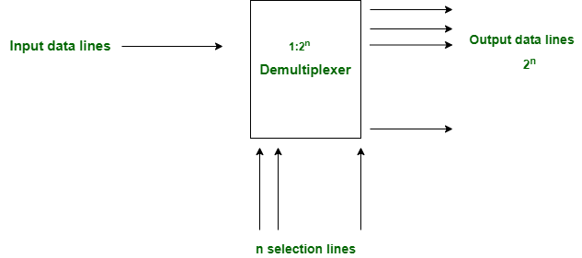
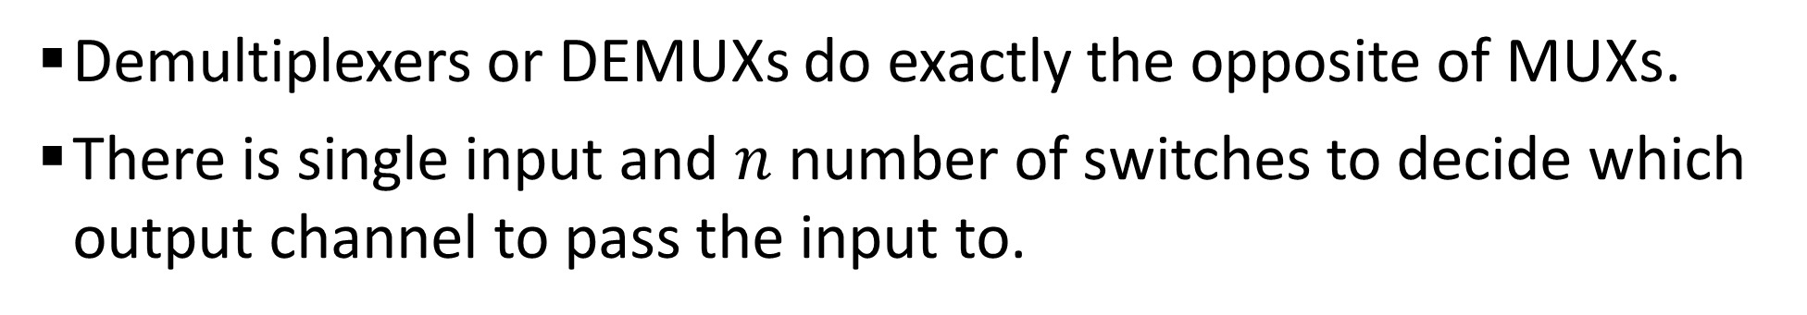
Sample 2
Demultiplexers
Demultiplexers or DEMUXs do exactly the opposite of MUXs.
There is single input and $n$ number of switches to decide which output channel to pass the input to.

Slide 14
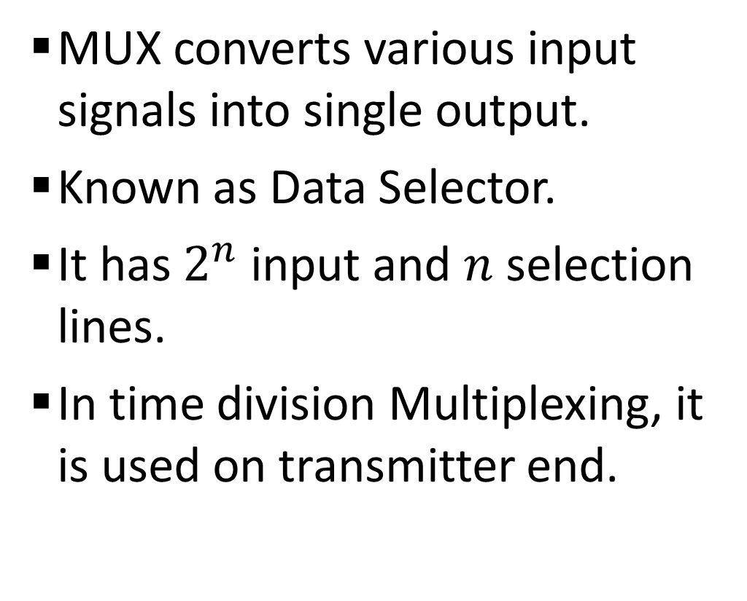
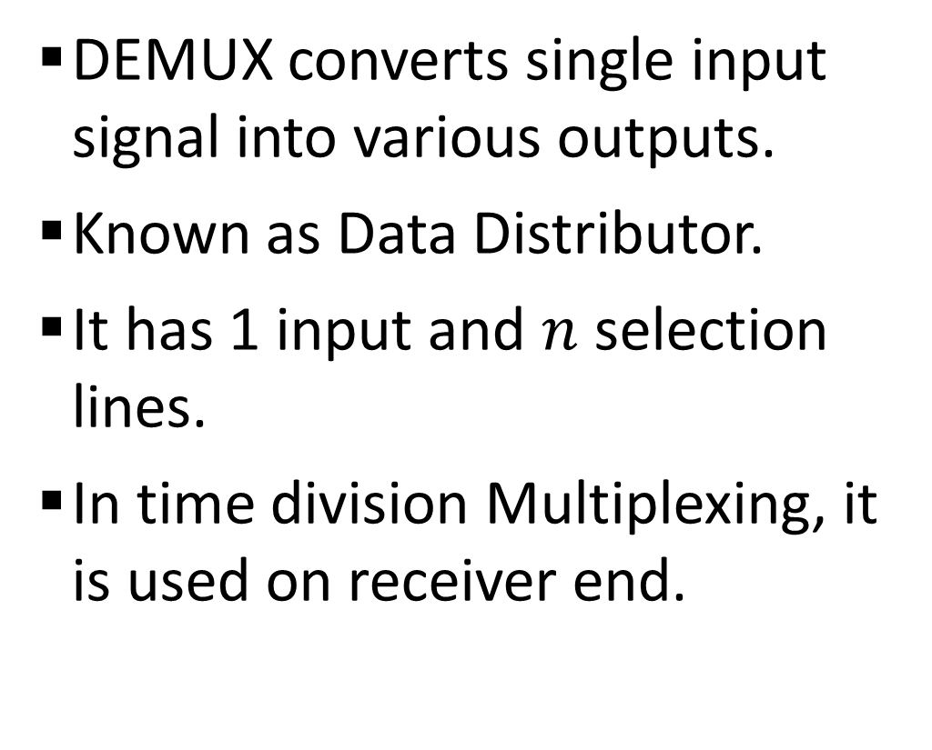
Sample 2
Differences between MUX and DEMUX
MUX converts various input signals into single output.
Known as Data Selector.
It has $2^{n}$ input and $n$ selection lines.
In time division Multiplexing, it is used on transmitter end.
DEMUX converts single input signal into various outputs.
Known as Data Distributor.
It has 1 input and $n$ selection lines.
In time division Multiplexing, it is used on receiver end.

Slide 15
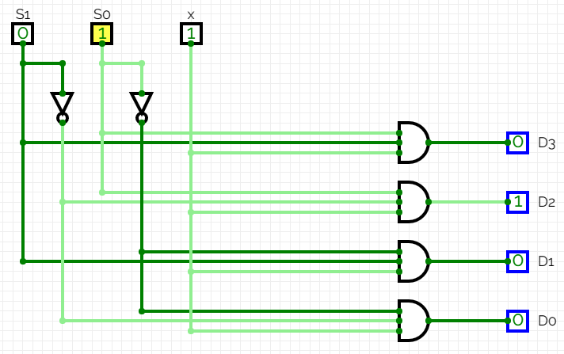
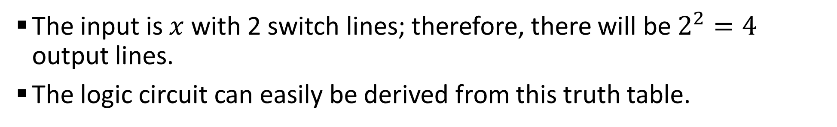
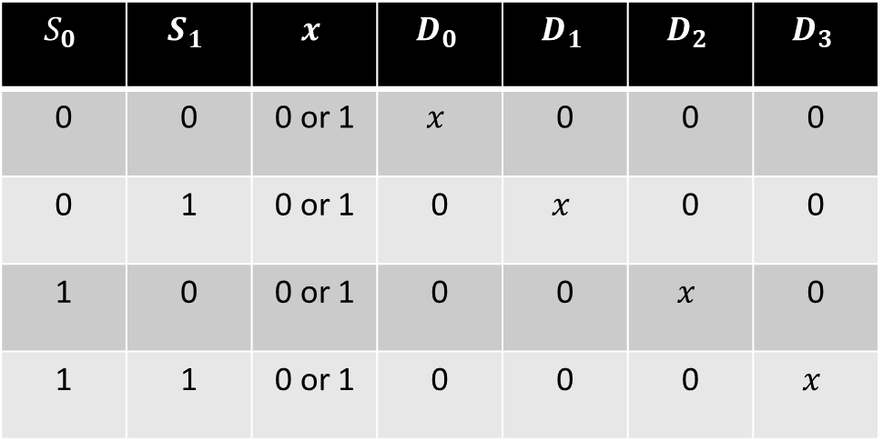
Sample 2
1-4 DEMUX
The input is $x$ with 2 switch lines; therefore, there will be $2^{2}=4$ output lines.
The logic circuit can easily be derived from this truth table.
$$S_{0}$$ | $$S_{1}$$ | $$x$$ | $$D_{0}$$ | $$D_{1}$$ | $$D_{2}$$ | $$D_{3}$$
0 | 0 | 0 or 1 | $$x$$ | 0 | 0 | 0
0 | 1 | 0 or 1 | 0 | $$x$$ | 0 | 0
1 | 0 | 0 or 1 | 0 | 0 | $$x$$ | 0
1 | 1 | 0 or 1 | 0 | 0 | 0 | $$x$$

Slide 16
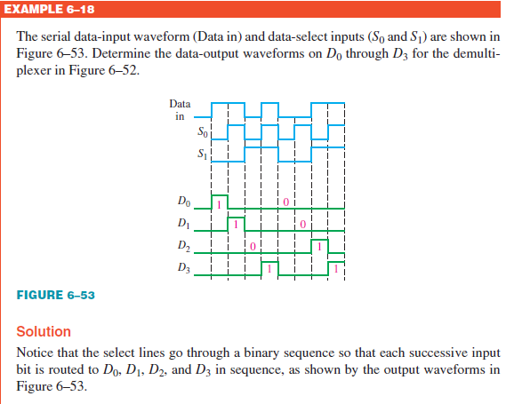
Sample 2
1-4 DEMUX
Given an input waveform and two selector switches, can you determine the number of output lines and their respective waveforms?

Slide 17
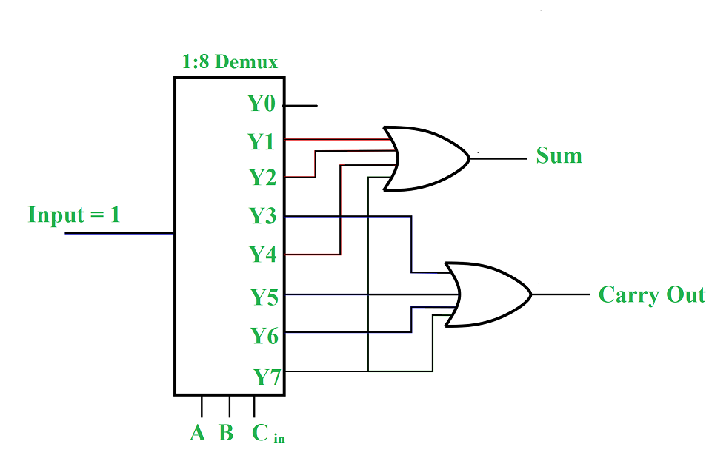
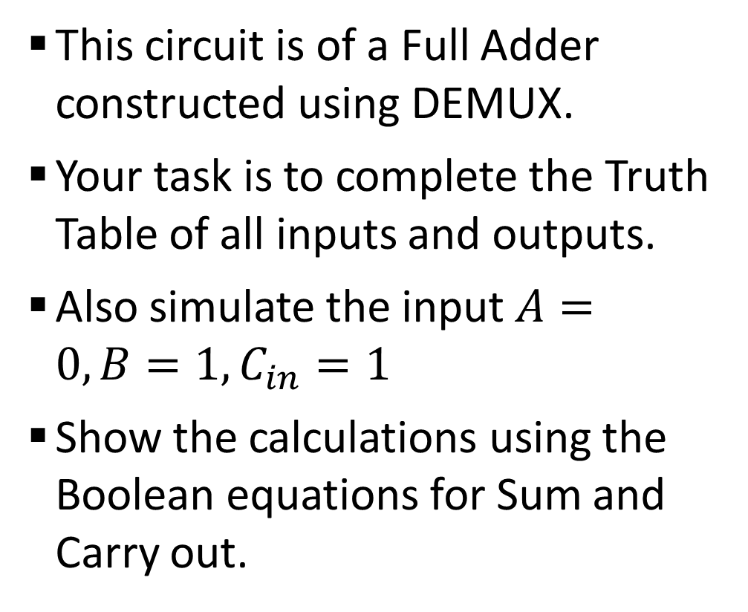
Sample 2
Assignment 3
This circuit is of a Full Adder constructed using DEMUX.
Your task is to complete the Truth Table of all inputs and outputs.
Also simulate the input $A=0,B=1,C_{in}=1$
Show the calculations using the Boolean equations for Sum and Carry out.

Slide 18
Sample 2
Assignment 3
Attempt these questions from textbook: Digital Fundamentals by Thomas Floyd (11th Edition)
Questions: 1b, 1c, 2a, 2d, 5, 8, 13, 14, 17b, 17d, 17h, 20, 22, 27a, 27c, 30, 31, 33

Slide 19



THANK YOU
Owais Hussain
+92 345-3174270
owais.hussain@kiet.edu.pk
https://www.researchgate.net/profile/Owais-Hussain-3

